Slide 1
UBER EATS RESTAURANT ANALYSIS
PRESENTED BY :- KATHAN PATHAK

Slide 2
INTRODUCTION
The Uber Eats Restaurant Analysis project aims to leverage the extensive dataset of over 100,000 U.S. restaurants from Uber Eats to extract valuable insights into the performance, trends, and characteristics of the food delivery industry.
By analysing various restaurant-related data, including restaurant names, categories, ratings, and locations, we aim to uncover patterns that can be used to make data-driven business decisions, improve customer experiences, and predict trends in the food delivery ecosystem.
With the available dataset from Kaggle, we can delve into the intricacies of Uber Eats' restaurant network, exploring factors such as restaurant type, rating distribution, location-based trends, and how various external factors (e.g., customer reviews, cuisine categories, or geographic areas) influence the success of restaurants on the platform. By combining the dataset with external data sources such as Yelp reviews, weather data, and market trends, we can generate actionable insights for both restaurant owners and delivery platforms.

Slide 3
API’S AND DATA
The api’s used here are :-
SCRAPPED DATA API :- https://www.yelp.com/biz/the-cheesecake-factory-los-angeles-3
Datasets :- Kaggle Uber Eats datasets :- Ubereat_US_Merchant.csv
YELP API FOR DEVELOPER :- https://partner-api.yelp.com/reviews/v1/

Slide 4
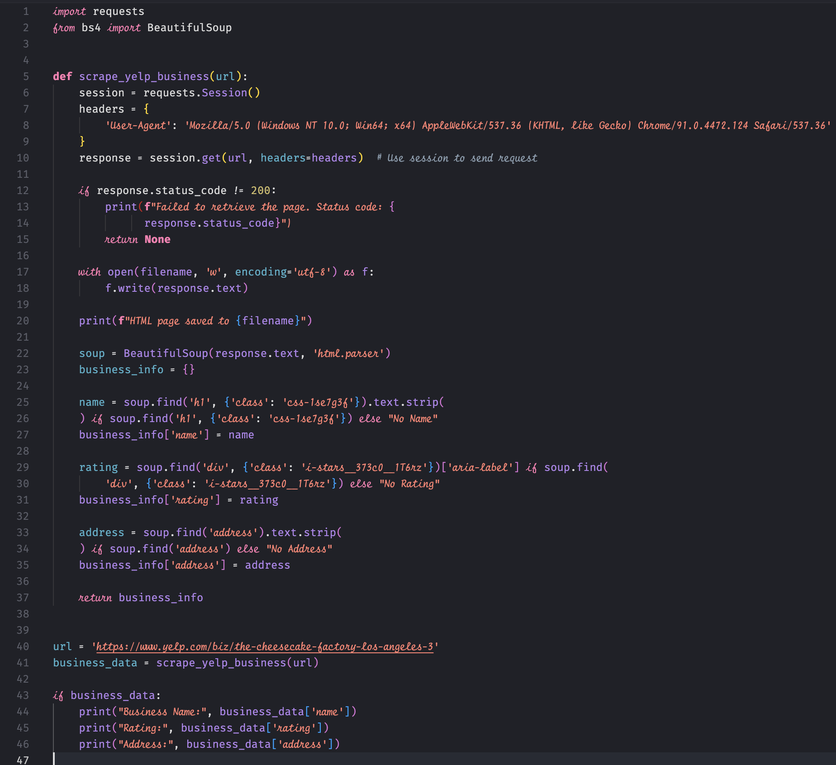
EXAMPLE OF SCRAPPED DATA

Slide 5
Review Rating Distribution
A histogram with a KDE curve highlights how review ratings are distributed across businesses.
Peaks indicate the most common ratings, while a wider spread shows variability in customer satisfaction.
For example, a peak near 4.0 could suggest most businesses have above-average ratings.
Conclusion: Understanding how ratings are distributed helps identify customer satisfaction trends. If the majority of ratings are clustered below 3, it indicates dissatisfaction, prompting businesses to investigate reasons for negative feedback.

Slide 6
Review Count Vs Rating
This scatter plot examines the relationship between the number of reviews and average ratings, categorized by price buckets.
Larger points represent businesses with higher review counts, while color indicates the price range.
Higher review counts are often associated with consistent ratings, whereas lower counts show variability.
Conclusion: Higher review counts generally indicate greater popularity or trustworthiness. However, businesses with low reviews and high ratings represent opportunities to enhance visibility.

Slide 7
Review Rating by Price Bucket
The box plot compares the distribution of review ratings for different price buckets.
Higher-priced businesses ($$$) often have higher median ratings, suggesting a correlation between price and quality.
However, some outliers indicate that not all expensive businesses deliver high satisfaction.
Conclusion: Price buckets influence customer expectations. Higher-priced businesses often have better ratings, but variability indicates potential mismatches in perceived value for money.

Slide 8
Review Ratings by City
This box plot highlights review ratings across different cities.
Cities with higher medians and narrower distributions indicate better and consistent customer experiences.
Variability in ratings for some cities suggests inconsistent service or varying expectations.
Conclusion: Cities with higher median ratings indicate regions with better customer experiences, while cities with high variability may need consistent quality standards.

Slide 9
Review Count Distribution
A histogram showcases the frequency of businesses with varying review counts.
Most businesses fall in the low-to-mid review count range, indicating newer or less popular establishments.
A long tail represents a few well-established businesses with significantly higher reviews.
Conclusion: A significant number of businesses with low review counts might indicate new entrants or lack of customer engagement.

Slide 10
Geospatial Distribution
A scatter plot maps the latitude and longitude of businesses, showing how they are geographically distributed.
Point size indicates the number of reviews, while color represents the average rating.
Clusters in specific areas may reveal hotspots of highly rated and frequently reviewed businesses.
Conclusion: Geographic clustering reveals high-performing hotspots and underserved regions. Areas with low ratings and high review counts may indicate a need for operational improvements.

